Slide 1
2022 KCCD Climate Survey
PC Results, College Council, February 2024

Slide 2
Climate Survey Background
First Implemented in 2011
  Focus was on questions of morale, trust, communication, participation, and campus interactions
  Repeated in 2013 and 2016 with minor changes/additions
Revamped in 2019
  Added questions on diversity, equity, and inclusion (DEI), discrimination, and harassment
  Changed scale on most previous questions, so responses are not comparable to previous versions
  Repeated again in 2022, with minor changes

Slide 3
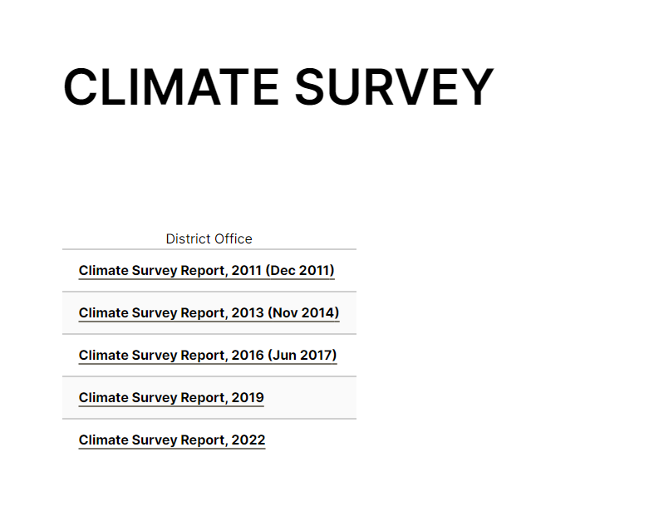
Summary Results Online

Slide 4
College Atmosphere
Satisfaction, Morale, Trust, and Work Environment

Slide 17
Participatory Governance
Decision-making, Communication, Information Flow, Participation

Slide 28
DEI
Diversity, Equity, Inclusion
Experience of Discrimination & Harassment

Slide 36
Questions/Next Steps?
?

