Slide 1

The Porterville college strategic Plan, 2021-2024
A focus on student success & Equity

Slide 2
Success & equity
Our primary focus is twofold:
  Improving student success metrics
  Reducing equity gaps
(Strategic Planning Committee focused on goals and objectives, not strategies)

Slide 3
Integrated
We are focused on integrating our strategic plan with other college documents, but particularly two primary initiatives
Guided Pathways (four pillars)
  Clarify the Path
  Enter the Path
  Stay on the Path
  Ensure Learning
Vision for Success
  Increase Certificates & Degrees
  Increase Transfers to CSU & UC
  Decrease Units to Complete
  Increase Employment in Field of Study
  Close Equity Gaps

Slide 4
Goals and objectives: how we set targets
We have dozens of data points to track in the draft plan; in some cases, several for a single objective.
We drafted targets for many, but not all of the data points. Some will be tracked, but without a specific target.
In deciding which data points should have specific targets to reach by the next strategic plan, we considered:
  The immediate importance of the data point
  The accuracy/reliability of available data
  Whether our current performance was already high, or had recently declined
  The impact of temporary pandemic effects on the data point

Slide 5
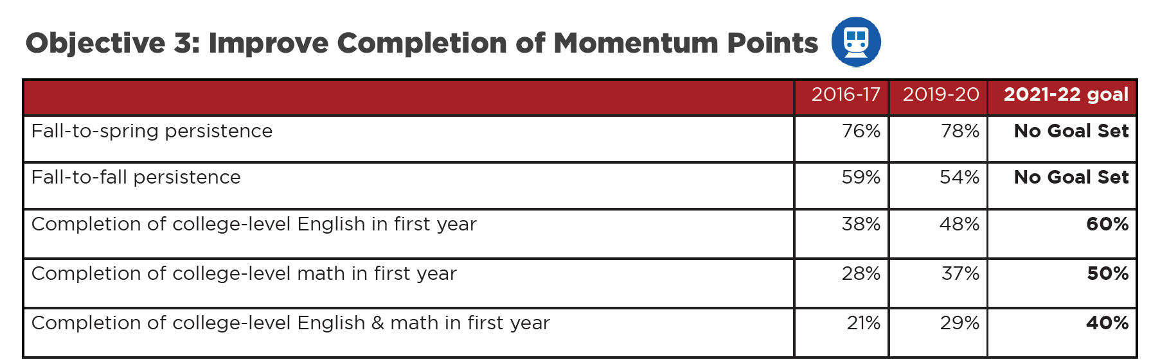
Goals and objectives: how we set targets
Example

Slide 6
Goals and objectives: how we set targets
For equity targets, we
  Focused on four student characteristics: gender, ethnicity, first-generation status, and DSPS participation
  Set targets where gaps are clear and consistent, not single-year anomalies
  Took group size into consideration, did not set targets for small groups
  We mostly set targets to cut achievement gaps in half

Slide 7
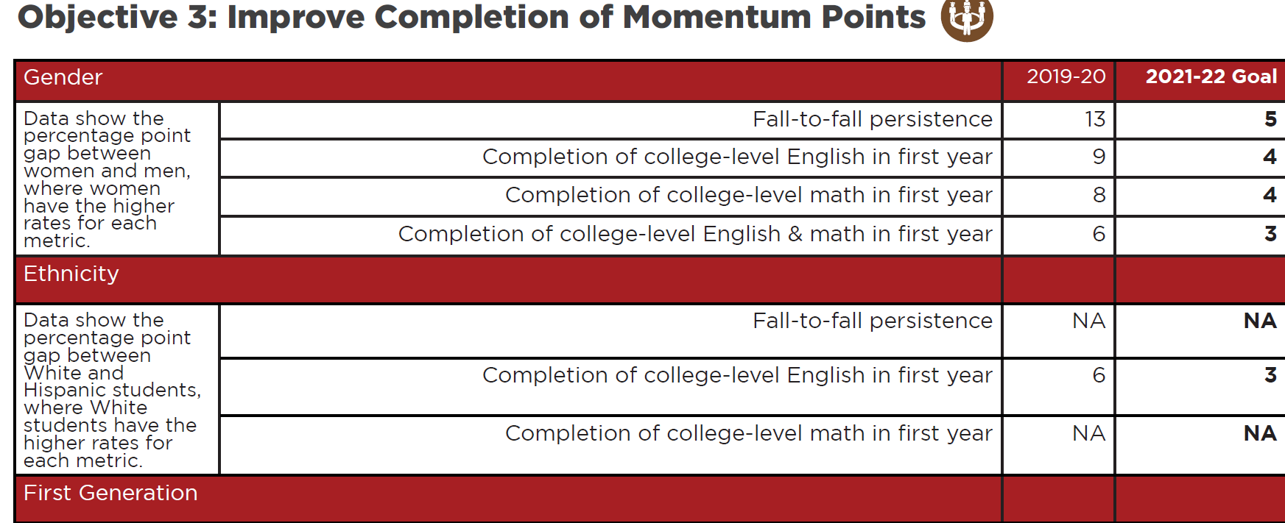
Goals and objectives: how we set targets equity example

Slide 8
Strategic Plan: introductory sections
Cover Page
PC Mission, Values, & Philosophy
President’s Message
Porterville Community page (basic community stats)
Student Profile

Slide 9
Strategic Plan: goal one, Increase student success
Objective 1: Improve Onboarding
Objective 2: Increase Student Engagement
Objective 3: Improve Completion of Momentum Points
Objective 4: Improve Completion Rates

Slide 10
Strategic Plan: goal two, close equity gaps
Reduce most equity gaps by half
Main equity areas identified: gender, ethnicity, first generation, and DSPS
Focus on three of the four student success objectives from goal one: onboarding, momentum points, and completion rates

Slide 11
Strategic Plan: goal three, enhance community connections
Objective 1: Provide Workforce Programs that Respond to Community Needs
Objective 2: Reflect and Interact with the Communities We Serve

Slide 12
Strategic Plan: goal four, strengthen organizational effectiveness
Objective 1: Meet and Exceed External Standards
Objective 2: Optimize Enrollment
Objective 3: Increase Trust & Collaboration
Objective 4: Provide Professional Development Opportunities
Objective 5: Improve Facilities, Maintenance & Safety

Slide 13

Next steps

