Slide 1
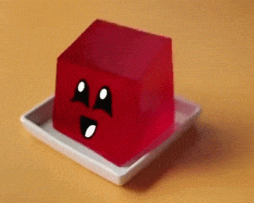
GELO Assessment
Curriculum Committee
August 27, 2024

Slide 2
Plan for GELO Assessment
Overview of GELOs
New GELO Statements
Timeline for GELO #2 Assessment
Improvement Plan for GELO #1

Slide 3
Welcome to GELO Assessment
What is a GELO exactly?

Slide 4
What Is a GELO?
A General Education Learning Outcome (GELO) is a statement about the knowledge, skills, attitudes, and/or abilities a student is expected to have upon successful completion of the General Education Areas for Porterville College.

Slide 5
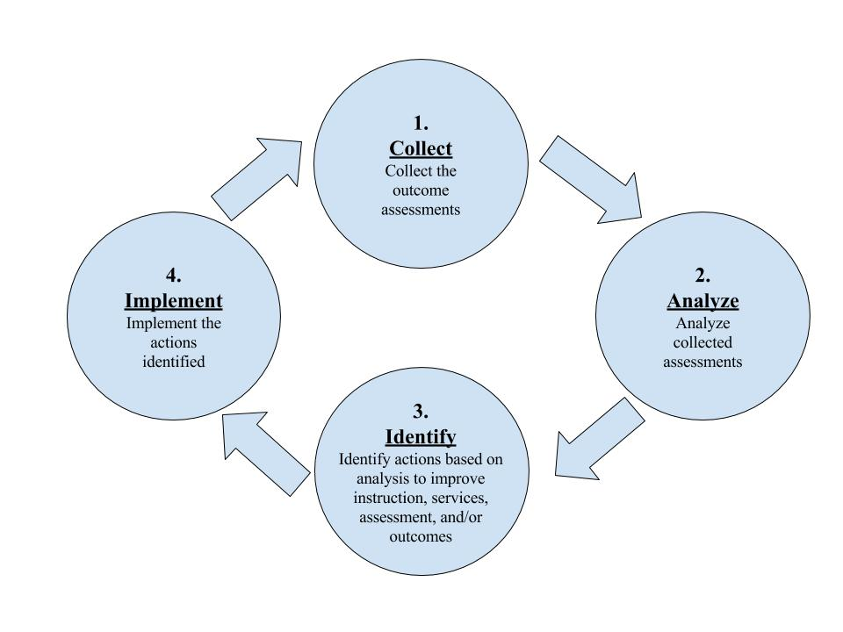

Slide 6
Gather evidence from across GE courses
Make a plan
Talk about the evidence
Identify how we can do better

Slide 8
New GELO Statements (Fall 2023)
Students communicate effectively and confidently using multiple modes (e.g. reading, writing, speaking, and listening) with consideration for medium, purpose, and audience.
Students use quantitative and qualitative thinking, tools, and processes to evaluate complex issues and gather, analyze, and synthesize information and data from multiple sources to formulate evidence-based arguments.
Students are prepared to actively participate as informed, responsible, and ethical citizens in political, social, cultural, and environmental matters.
Students are prepared to adapt to change, enhance wellness, practice reflection, collaborate with others, and work towards personal and professional goals.

Slide 9
New GELO Statements (Fall 2023)
Students communicate effectively and confidently using multiple modes (e.g. reading, writing, speaking, and listening) with consideration for medium, purpose, and audience. (Spring 2024)
Students use quantitative and qualitative thinking, tools, and processes to evaluate complex issues and gather, analyze, and synthesize information and data from multiple sources to formulate evidence-based arguments. (Fall 2024)
Students are prepared to actively participate as informed, responsible, and ethical citizens in political, social, cultural, and environmental matters. (Spring 2025)
Students are prepared to adapt to change, enhance wellness, practice reflection, collaborate with others, and work towards personal and professional goals. (Fall 2025)

Slide 10
New GELO Statements (Fall 2023)
Students communicate effectively and confidently using multiple modes (e.g. reading, writing, speaking, and listening) with consideration for medium, purpose, and audience.
Students use quantitative and qualitative thinking, tools, and processes to evaluate complex issues and gather, analyze, and synthesize information and data from multiple sources to formulate evidence-based arguments.
Students are prepared to actively participate as informed, responsible, and ethical citizens in political, social, cultural, and environmental matters.
Students are prepared to adapt to change, enhance wellness, practice reflection, collaborate with others, and work towards personal and professional goals.

Slide 11
Timeline for GELO #2 Assessment
September 10th: Create a rubric to assess assignments; distribute assessment packets
September 26th, October 8th, & October 22nd: Discuss assignment prompts and student work
November 12th: Assess how well our students are demonstrating the outcome
November 24th: Create a plan for improvement

Slide 12
Improvement Plan for GELO #1
Students communicate effectively and confidently using multiple modes (e.g. reading, writing, speaking, and listening) with consideration for medium, purpose, and audience.
Improvements in Teaching to the Outcome
Consider teaching students to communicate with confidence
(Instructors of GE courses)
Improvements in Assessing the Outcome
Share the conversations we are having about GELOs with our divisions including where we have assumptions (for example, that confidence is implied)
(Division representatives)
Improvements in Assessing the Outcome
Consider putting GELOs on GE course syllabi
(Curriculum Chair take the idea to the Academic Senate)

Slide 13
Homework
By Friday, September 6th:
Send me the two GE-course assessment packets from your division (preferably from different disciplines)
Each packet should have
Assignment prompt
3 student samples
Clearly demonstrating outcome
Borderline demonstrating outcome
Falling short of demonstrating outcome
GELO #2: Students use quantitative and qualitative thinking, tools, and processes to evaluate complex issues and gather, analyze, and synthesize information and data from multiple sources to formulate evidence-based arguments.

