Slide 1
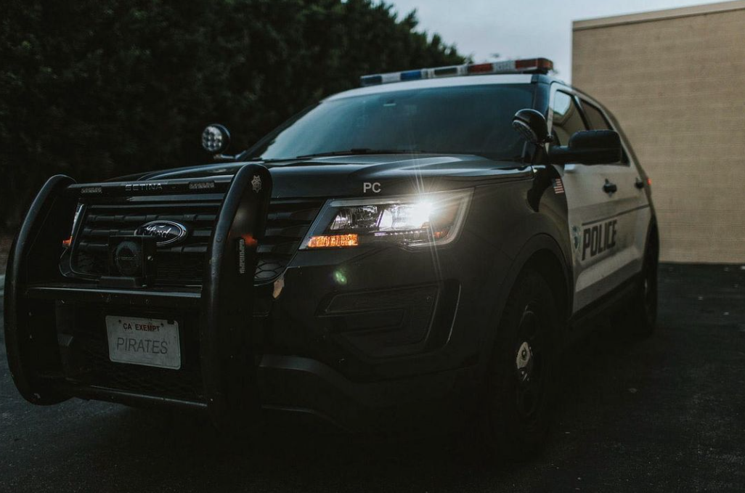
Porterville College Baccalaureate Degree Program
Modern Police Science
Application Proposal Presentation

Slide 2
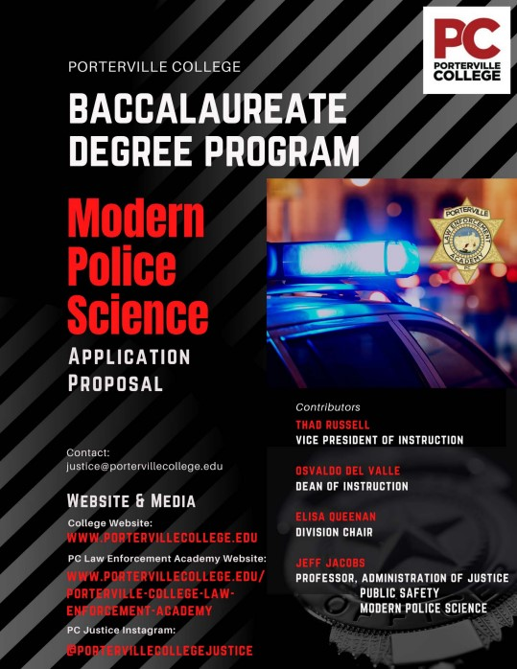
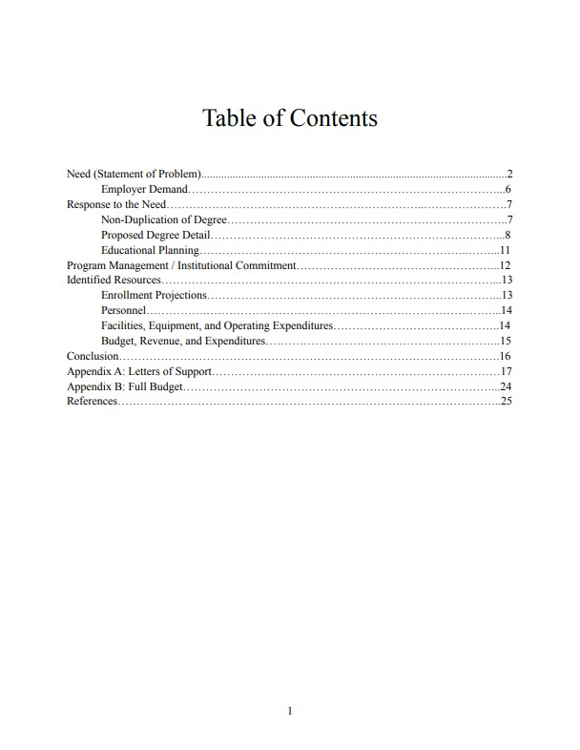
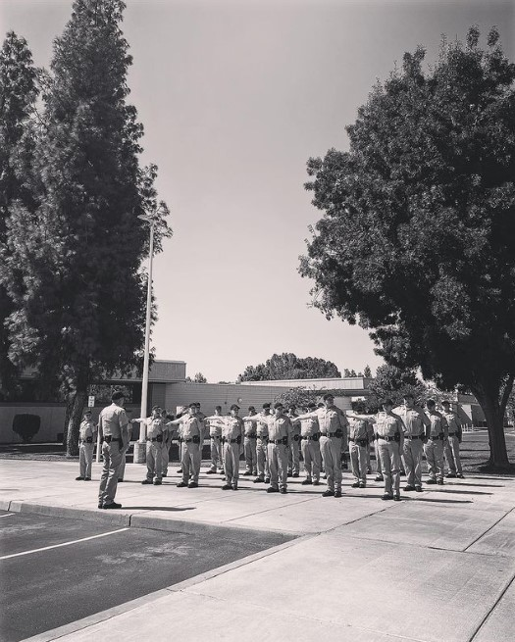

Slide 3
Baccalaureate Degree Program BDP
In 2021, Governor Gavin Newsom signed Assembly Bill 927, which makes the baccalaureate programs being piloted at 15 community colleges permanent and allows other community colleges in California to apply for new bachelor’s programs at their colleges.
The state is offering two application periods each year and will approve up to 15 bachelor’s applications for each application period.
Modern Police Science B.S.

Slide 4
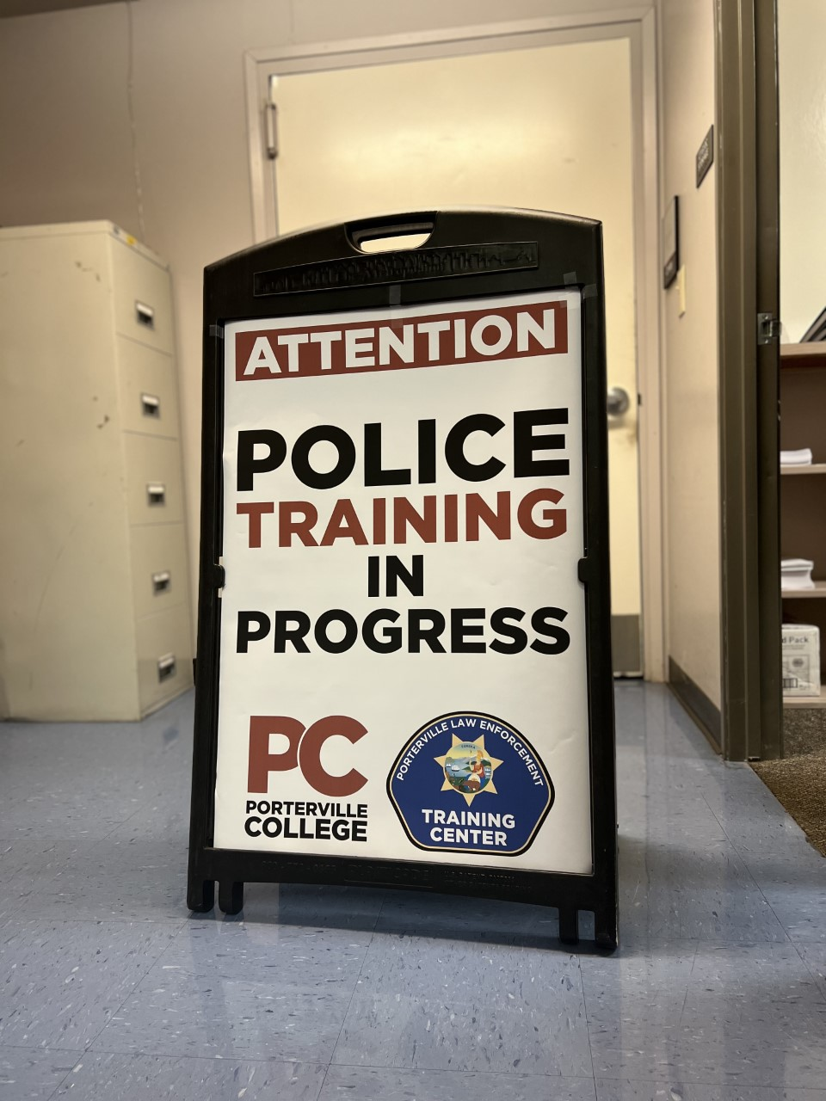
Modern Police Science Bachelor’s Degree Necessity
PEACE ACT (CA Assembly Bill 89)
This bill requires the office of the Chancellor of the California Community Colleges to develop a modern policing degree program, with the commission and other stakeholders to serve as advisors.
Existing law requires peace officers in this state to meet specified minimum standards, including age and education requirements.
This bill will require incoming officers to have a bachelor’s degree (which must contain modern policing education) by 2025.
Studies show that better educated officers perform better in the academy, receive higher supervisor evaluations, have fewer disciplinary problems and accidents, are assaulted less often, and miss fewer days of work than their counterparts.

Slide 5
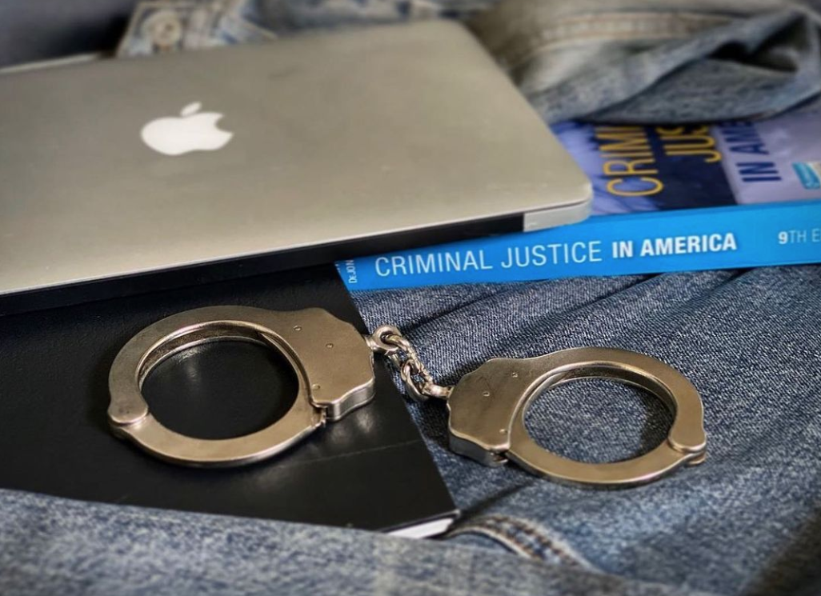
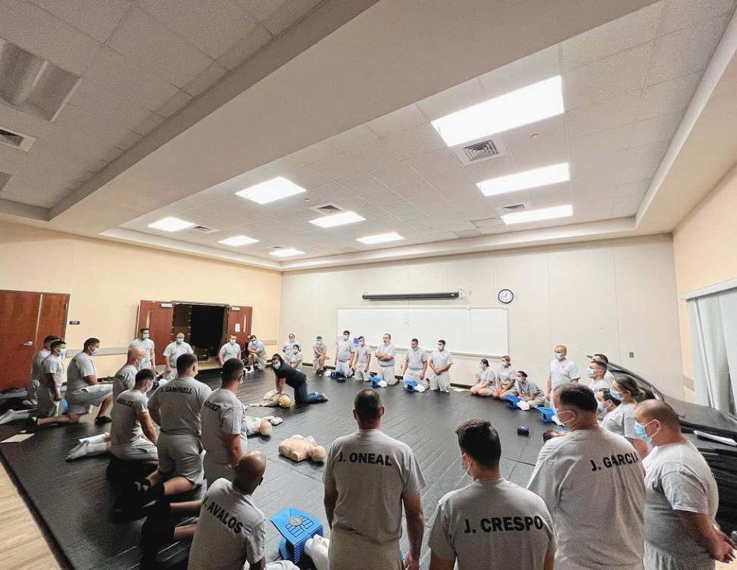
Modern Police Science Bachelor’s Degree at PC
The Modern Police Science degree is intended to build specific skills for law enforcement officers through career relevant curriculum and the selection of appropriate upper division requirements.
Specifically, this degree will train students to perform “the duties of police and public security officers, including patrol and investigative activities, traffic control, crowd control and public relations, witness interviewing, evidence collection and management, basic crime prevention methods, weapon and equipment operation and maintenance, report preparation and other routine law enforcement responsibilities” (CIP Code, 43.0107).
PC Law Enforcement Cadets learn CPR and first aid from local, knowledgeable, law enforcement leaders.

Slide 6
Modern Police Science Bachelor’s Degree at PC
Our proposal advocates for a Bachelor of Science degree at Porterville College, which will satisfy the educational requirements outlined in California Assembly Bill 89.
Upon successful completion of the proposed degree (and completion of POST academy), graduates of the program will be eligible for employment as law enforcement officers locally, as well as anywhere in the state.
The availability of this career related degree would allow our college to offer a much needed educational resource to a population that lives more than 50 miles from the nearest four-year institution (most of which do not offer a degree in modern police science) at a more affordable price.

Slide 7
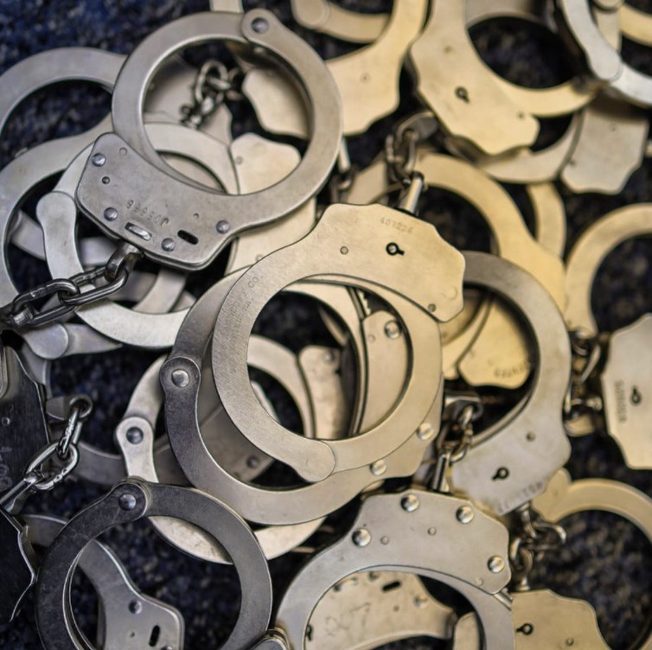
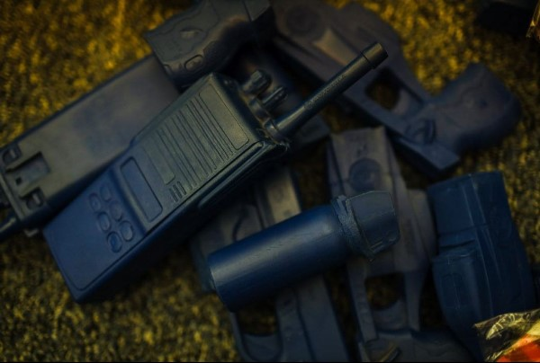
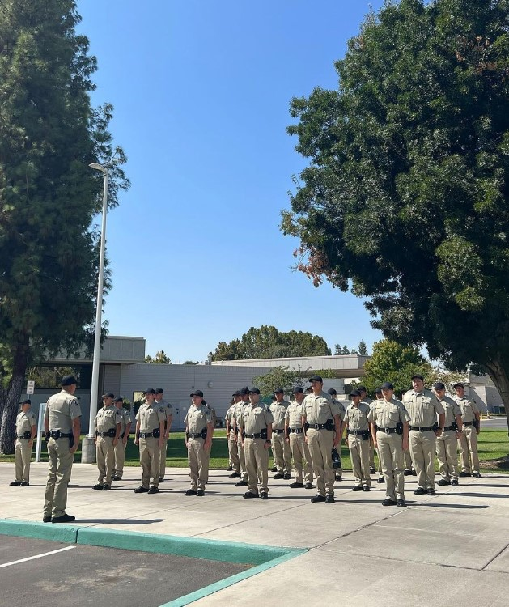
Potential Bachelor Level Courses
Within Modern Police Science
PSCI 200 - Foundations, Functions, and Procedures of Policing
PSCI 201 - Community and Crisis Communication
PSCI 202 - Constitutional Criminal Procedure
PSCI 203 - Police and Civil Rights
PSCI 204 - Crime Scene Procedures and Investigations
PSCI 205 - Crime Prevention, Analysis, and Modern Police Technology
PSCI 206 - Capstone Project

Slide 8
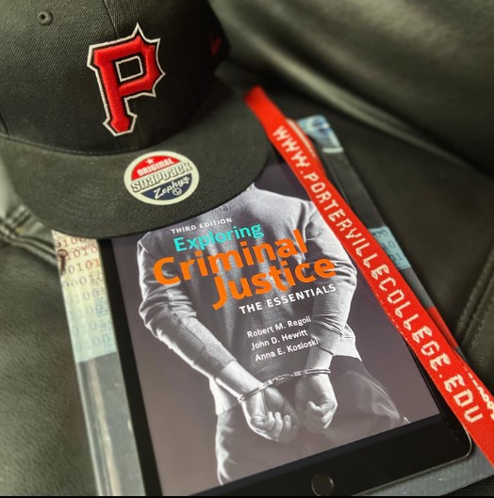
Baccalaureate Requirements Outside of Justice Program
"Each baccalaureate degree must require a minimum of 24 semester or 36 quarter units of upper division coursework including, a minimum of nine semester units of upper division general education courses.”
Nine units of upper division coursework in:
Math (computation)
English (written communication)
Sociology (social science / psychology)

Slide 9
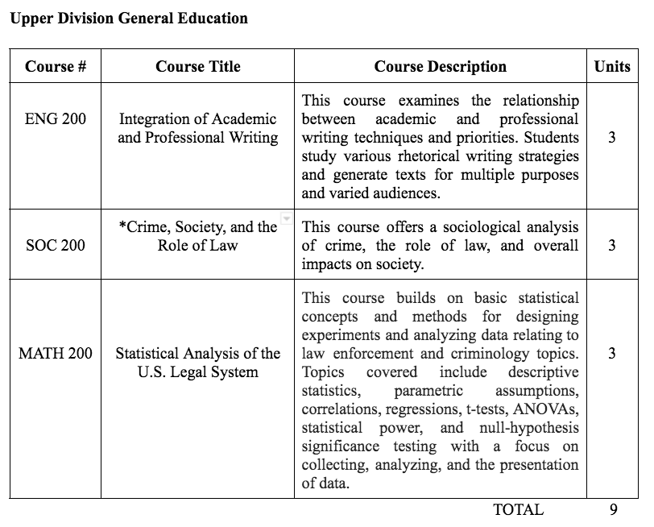
EXAMPLE ONLY

Slide 10
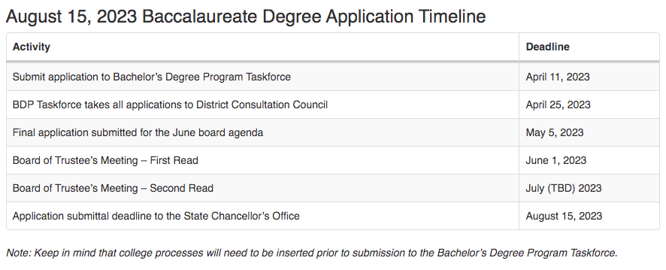
Timeline
Above information available at http://kccd.edu/bdp

Slide 11
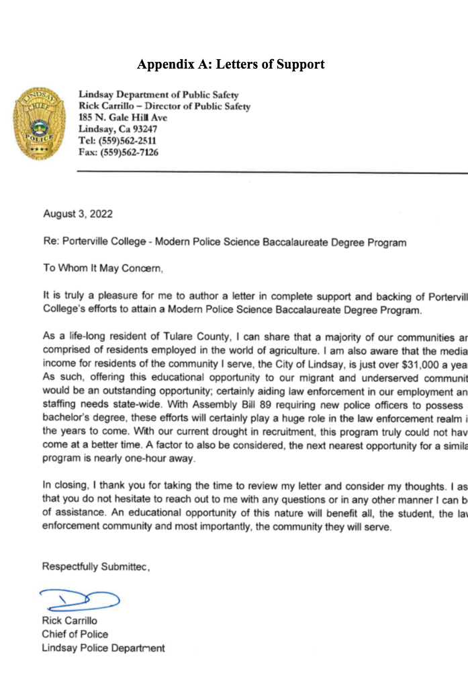
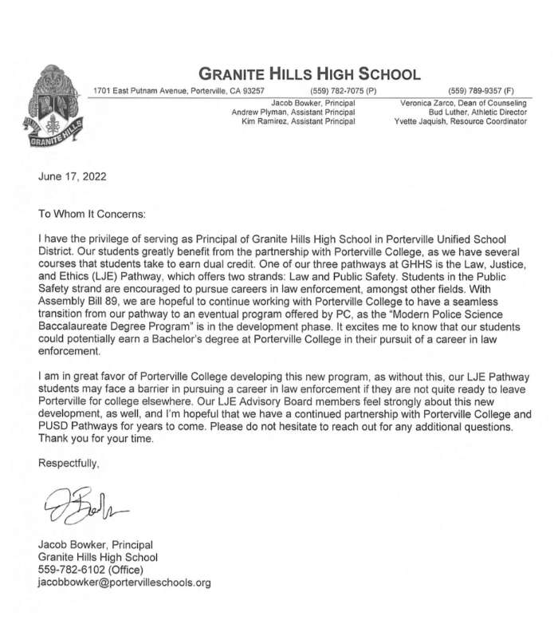
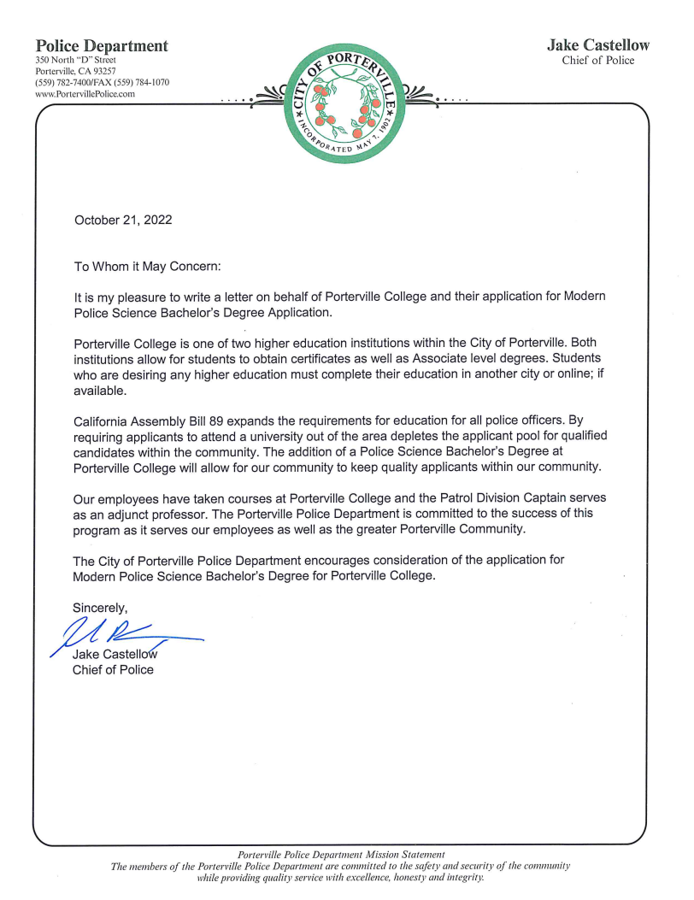
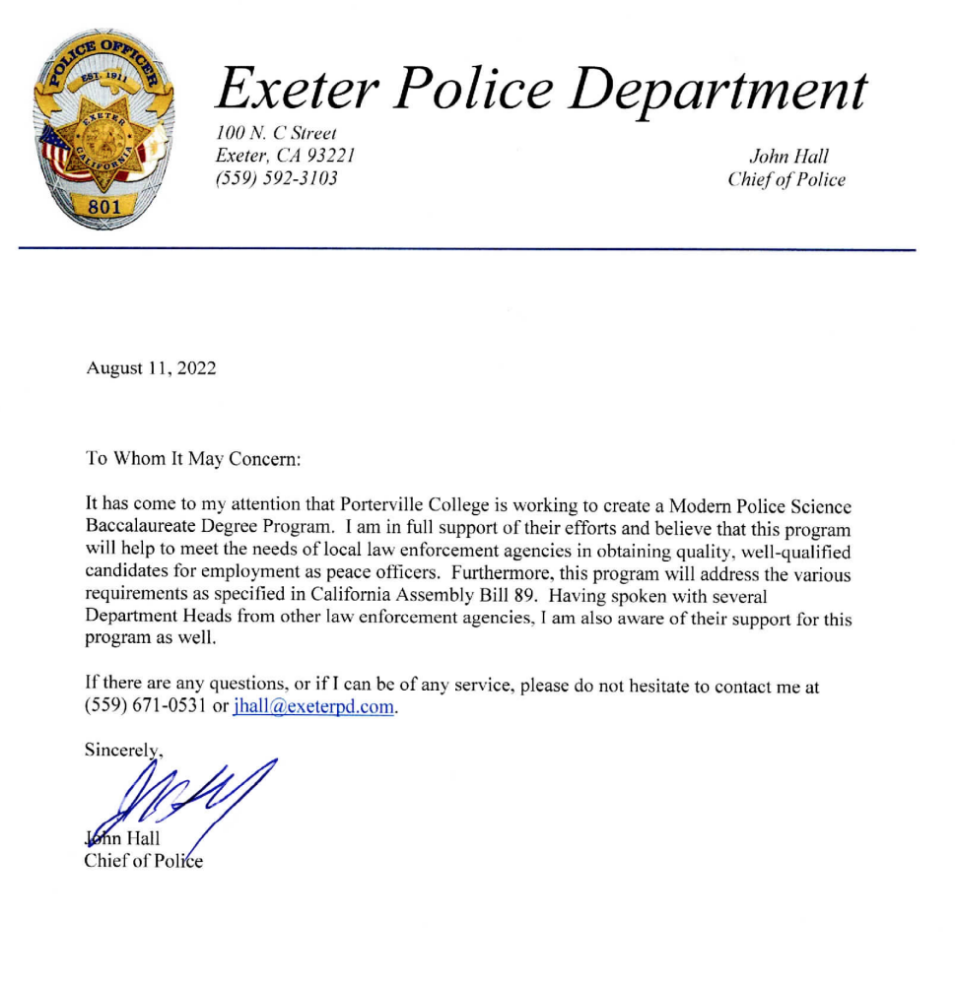
Community Support
PC has a great deal of community support behind this degree.
The program author has sat down with almost every law enforcement leader in the county during the creation of this application.

Slide 12
Questions?
Jeff Jacobs
Administration of Justice
Public Safety
Modern Police Science
email: jeffrey.jacobs@portervillecollege.edu
Instagram: @portervillecollegejustice

