Slide 1
AB927 Implementation
Presented to Porterville College enrollment management committee
By: Liz Rozell, Todd Coston
Date: March 28, 2022
Notes:
Todd will do introductions

Slide 2
Brief History
Governor opens a pilot program for CA Community Colleges
Jan 20, 2015 - BC applies and receives approval to pilot the Bachelor of Science in Industrial Automation degree
Pilot had a time limit; legislation was repeatedly proposed to make the baccalaureate degree program permanent
October 2021 AB 927 makes the pilot Baccalaureate Programs permanent
Legislation allows the state to award up to 15 new Bachelor’s twice a year
KCCD is only allowed to submit one proposal each application period
Notes:
Todd

Slide 3
Program Considerations
Explore the viability of the proposed baccalaureate degree considering the following elements:
The degree cannot be duplicated at any CSU or UC
TOPs code cross-walked to a CIP
CIP code cannot be offered at any CSU or UC
Existing associate degree pathway to the baccalaureate degree
Associate degree cannot be discontinued
Evidence of unmet workforce demand for the baccalaureate degree
Notes:
Liz

Slide 4
Program Considerations (cont.)
Evidence of consultation with regional employers & workforce development boards
Evidence of relevant statewide and regional workforce data demonstrating workforce need
Documentation of consultation with CSU and UC systems
Notes:
Liz

Slide 5
KCCD Process
College Process
District Process
Chancellor
Notes:
Todd

Slide 6
College Process
Proposal is vetted through a defined College process. (college needs to develop this process)
At most one proposal submitted to KCCD by the College President for any application cycle
Begin ACCJC Substantive Change Application (Ready to submit if application is approved)
College Process
District Process
Chancellor
Notes:
Liz

Slide 7
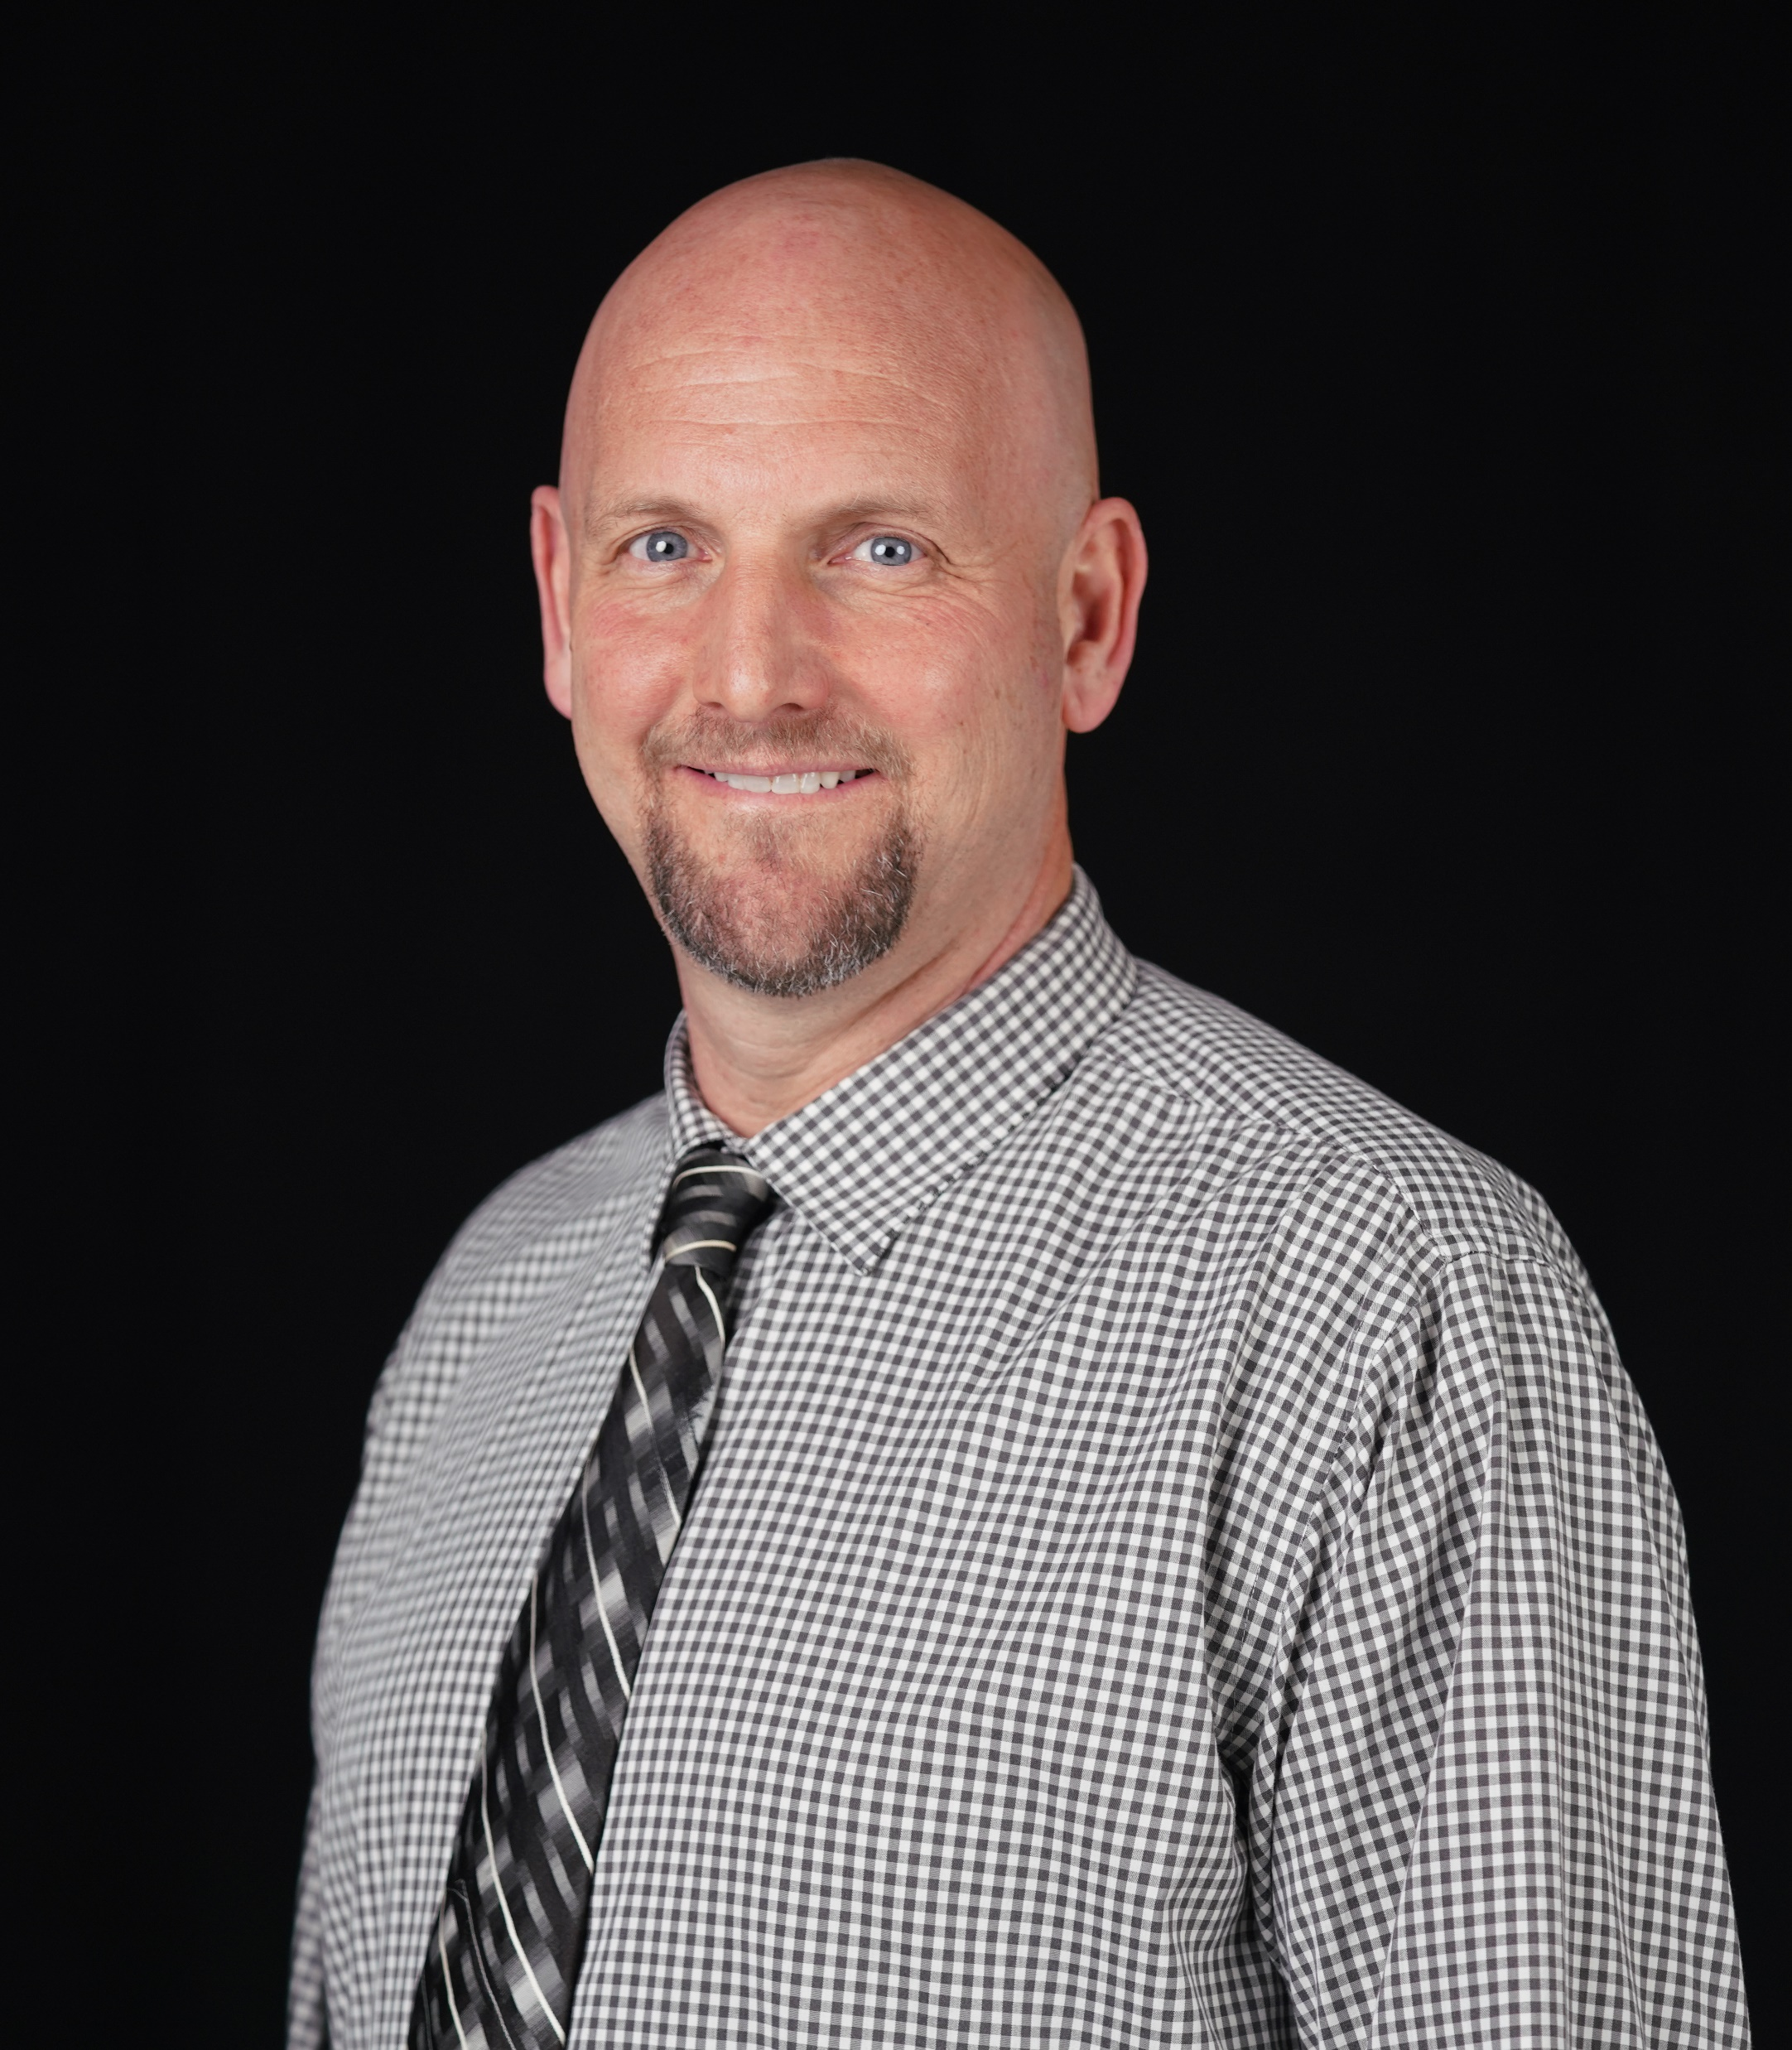
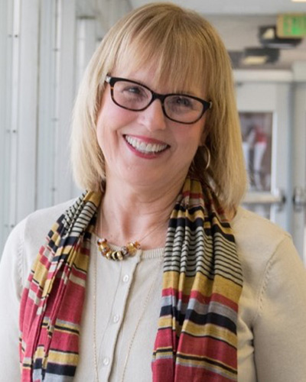
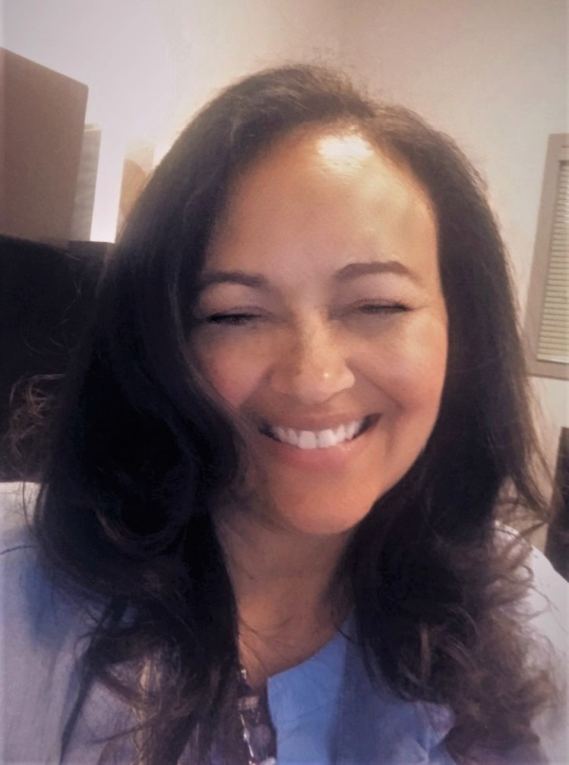
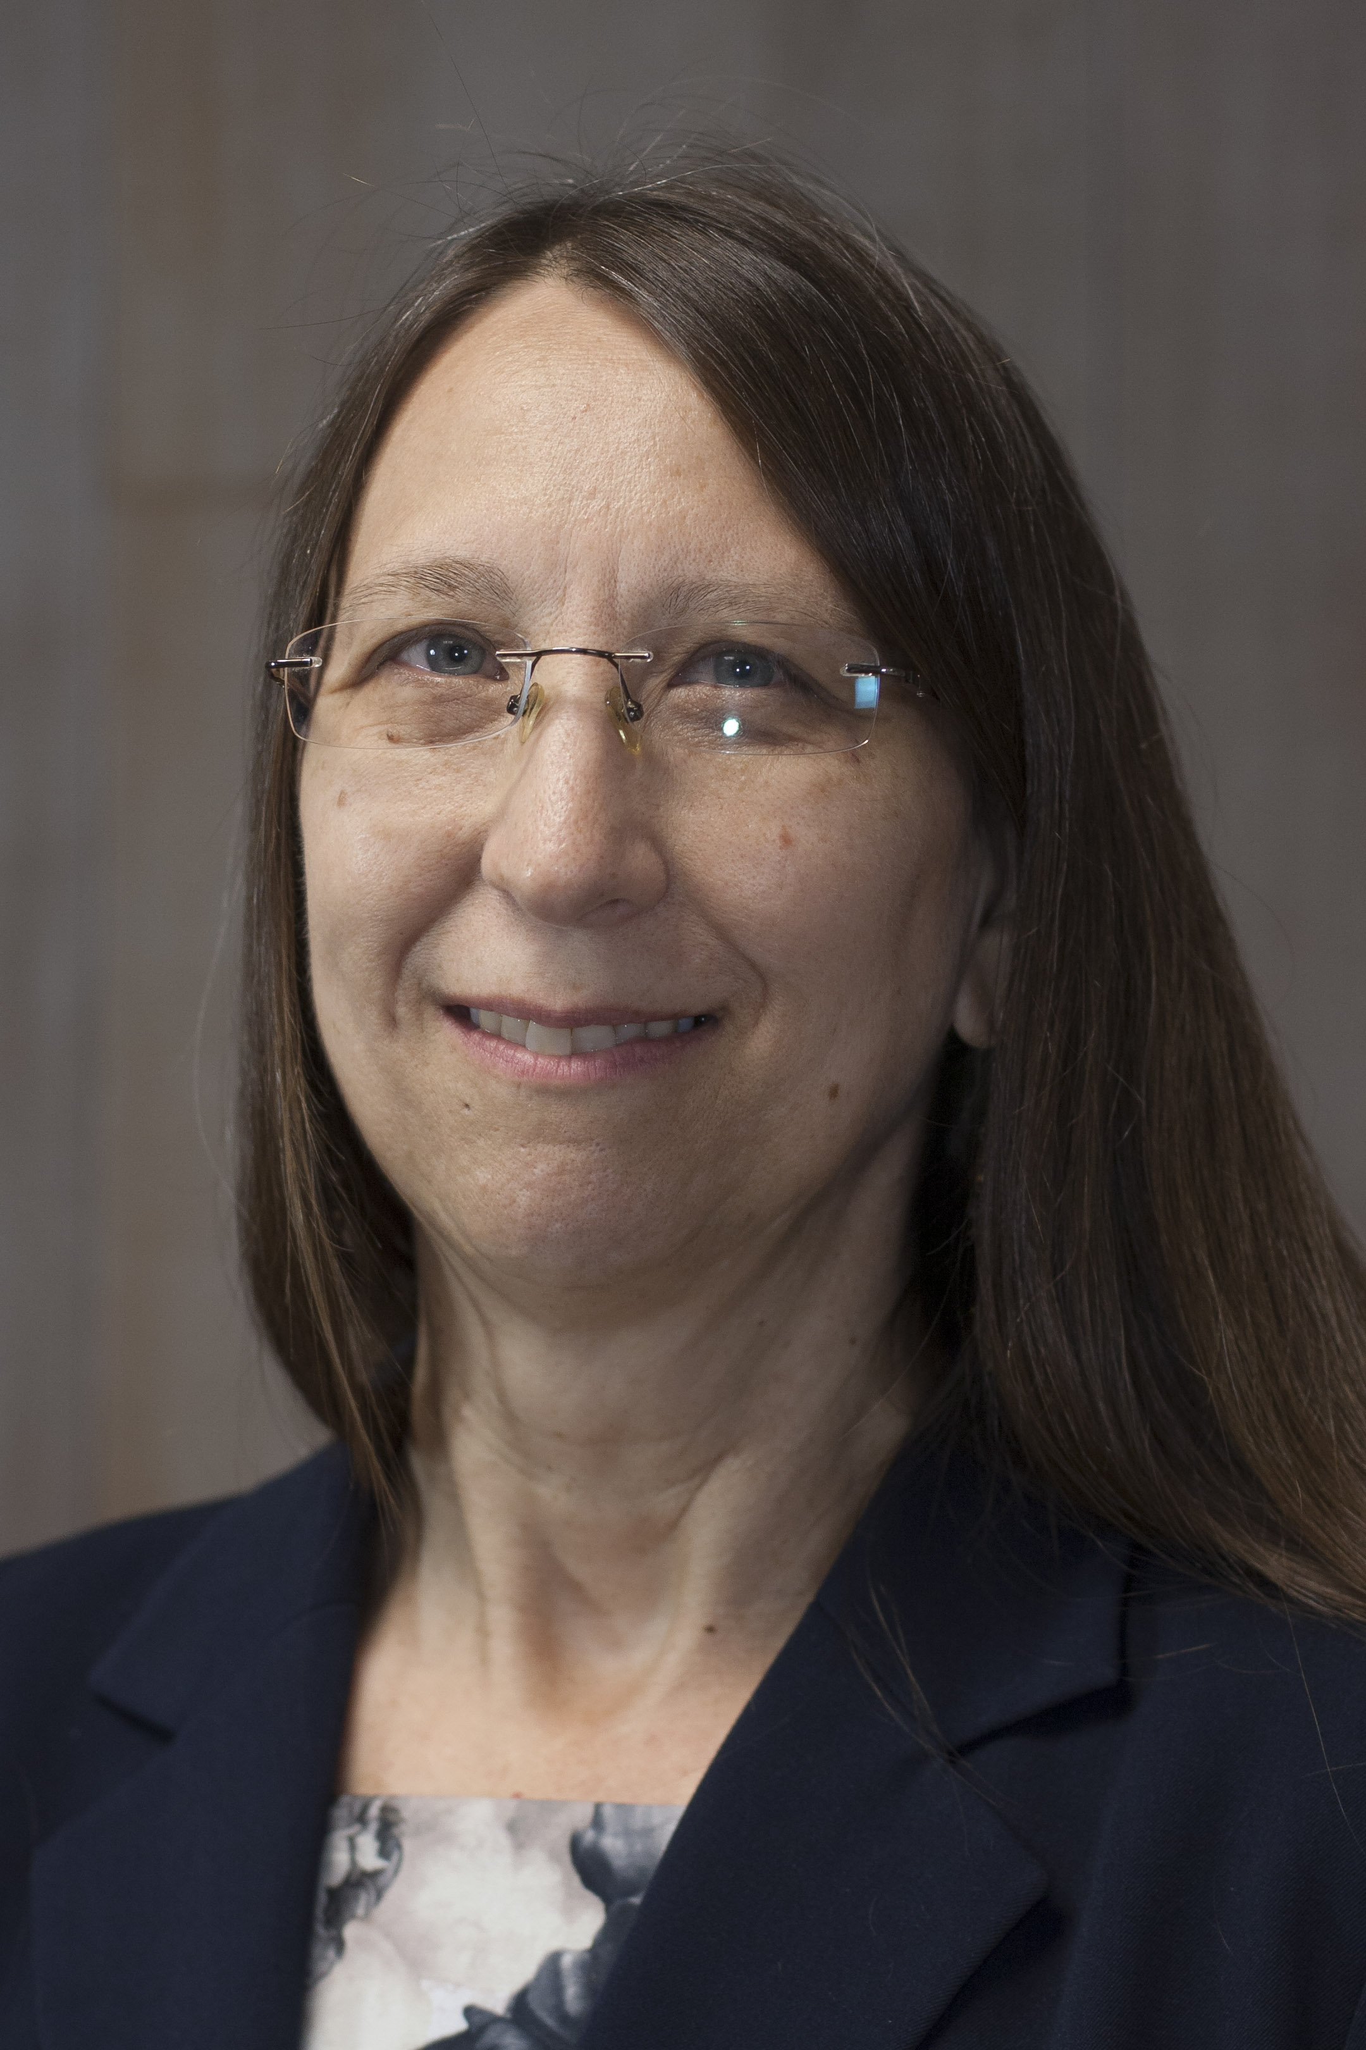
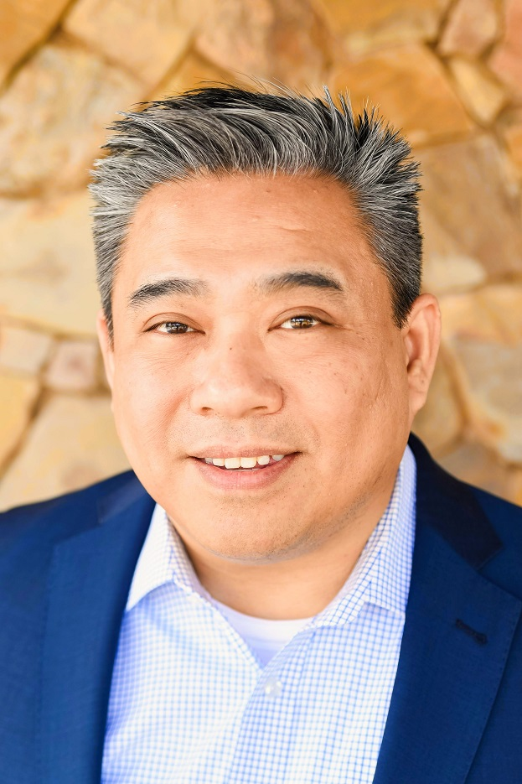
District Process: BDP Task Force
Todd Coston, Interim Associate Vice Chancellor Planning and Educational Technology
Liz Rozell
Director, Valley Strong Energy Institute
Trudy Gerald, Associate Vice Chancellor- Economic & Workforce Development
Bonita Steele, Director, Career Pathways, Programs and Compliance
Bob Ngo, Executive Director, Institutional Research and Reporting
Jessica Grimes, Dean, Economic and Workforce Development
College Process
District Process
Chancellor
Notes:
Todd – Introduce the team

Slide 8
District Process
BDP Task Force
Evaluate and analyze proposals
Present the task force report to District Consultation Council for discussion
College Process
District Process
Chancellor
Notes:
Liz

Slide 9
Chancellor
Executive Team - Chancellor will make final decision
One application can be submitted by KCCD per application cycle
Application goes to KCCD Board of Trustees for approval
Application is submitted to the state by application date
College Process
District Process
Chancellor
Notes:
Todd

Slide 10
District Timelines
Submit proposal to KCCD for Consultation Council Review | April
Submit proposal for June KCCD BOT meeting | May
First read for BOT | June board meeting
Second read for BOT | July board meeting
Last day to submit proposal to CCCCO | August 15th
Submit proposal to KCCD for Consultation Council Review | September
Submit proposal for June KCCD BOT meeting | October
First read for BOT | November board meeting
Second read for BOT | December board meeting
Last day to submit proposal to CCCCO | January 15th
Notes:
Liz

Slide 11
Need Help?
Resources:
Email to baccalaureate@kccd.edu
Invite BDP members to a meeting
http://www.kccd.edu/bdp (in-progress)
Notes:
Todd

Slide 12
Can we answer any questions?

