Slide 1
Accreditation Institution set standards and stretch goals
College council, April 5, 2021

Slide 2
Purpose
The accrediting commission (ACCJC) requires us to establish and monitor two types of standards for several student success metrics. These include Institution Set Standards (ISS) and Aspirational (Stretch) goals

Slide 3
Institution set standards
Institution Set Standards are a “floor” metric below which the college should expect never to fall. Should we drop below this standard, we should be taking notice, and in some cases, immediate action.

Slide 4
Stretch goals
Stretch goals are aspirational. Not “pie in the sky,” but above our usual level of performance, a level at which we hope to achieve. Ambitious, but achievable.

Slide 5
Which metrics
Institutional Set Standards and Stretch Goals can vary from year to year, but currently must be set for metrics such as:
Course success rates
Associate’s Degrees Awarded
Certificates Awarded
Transfers
Licensure Pass Rates for CTE Programs
Job Placement Rates for CTE Programs

Slide 6
How do we set goals? (Something more than random)

Slide 7
institution set standards
Consider past performance
How low is too low?
Don’t just pick the lowest recent year (you’ll never fall below)
Some metrics vary more than others
Apply appropriate statistical techniques

Slide 8
Setting an institutional set standard
A level below which we should aspire never to fall below

Slide 9
Standard deviation
Standard deviation is a measure of the amount of variation in a set of values
Example 1: values, 10, 20, 50, 100, 500; STDEV=206.5
Example 2: values 10, 15, 20, 25, 35; STDEV=9.6
Standard deviation shows how much a set of values tends to vary

Slide 10
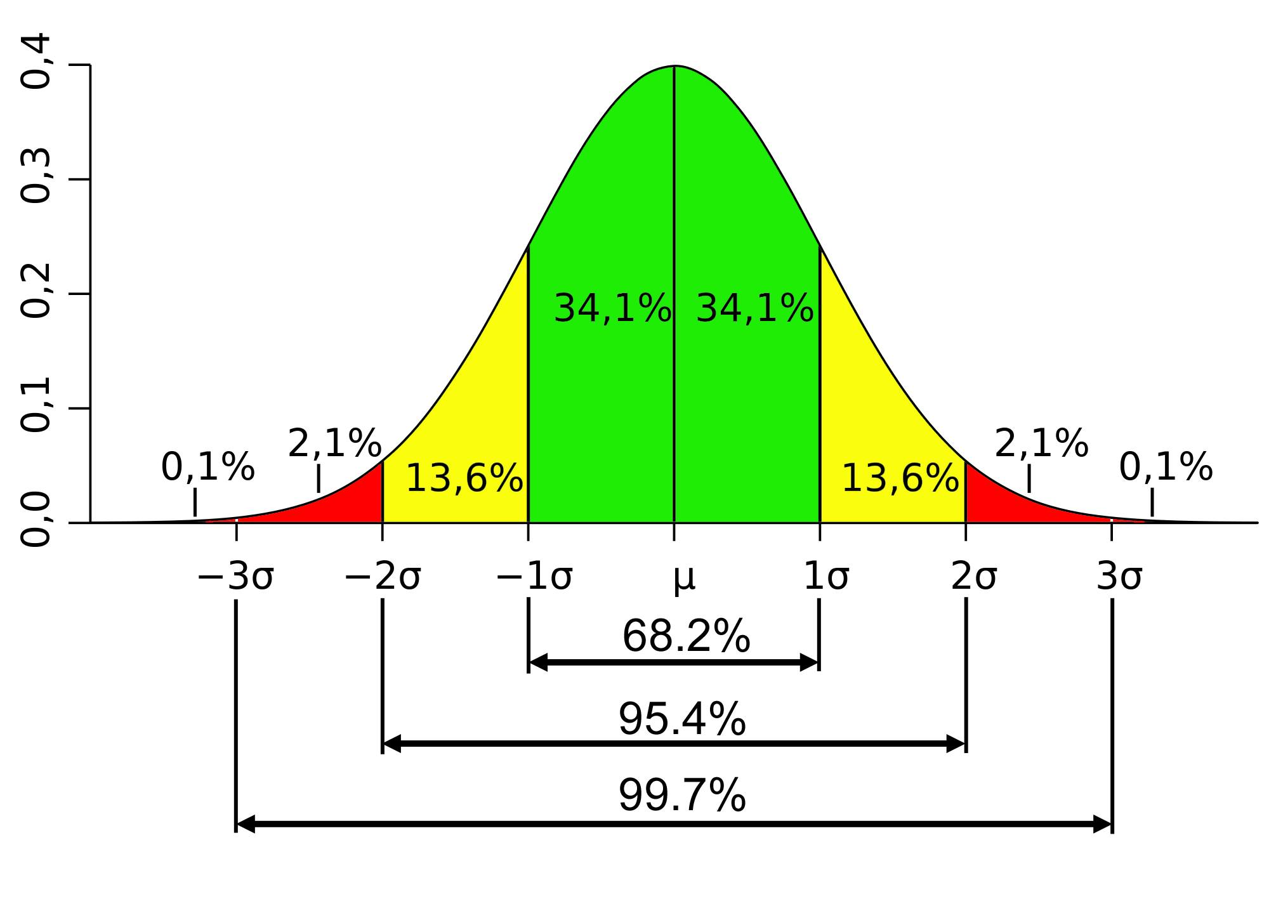
Standard deviation
In a typical distribution, two thirds of the potential values will fall within one standard deviation of the mean, 95% within two standard deviations, more than 99% within three.

Slide 11
Applying this to institution set standards
Example 1: Successful Course Completion
Past five years:
2015-16: 71.0%
2016-17: 72.5%
2017-18: 74.5%
2018-19: 76.6%
2019-20: 73.9%
Five year mean (average): 73.7%
Standard Deviation: 2.1%
Institution Set Standard: 71.6%; we should not fall below this

Slide 12
ISS Using standard deviation
The statistical principle here is that it because 68% of cases would fall within one standard deviation of the mean, it would be unlikely that we would fall below that level due to chance.
So, we set an ISS at 71.6% because it is unlikely we would fall below that under normal circumstances. Therefore doing so violates our usual expectations

Slide 13
Applying this to institution set standards
Example 2: Associate Degrees Earned
Past five years:
2015-16: 433
2016-17: 439
2017-18: 502
2018-19: 696
2019-20: 837
Five year mean (average): 581
Standard Deviation: 178
Institution Set Standard: 403; we should not fall below this.

Slide 14
Setting Stretch goals
Goals we should aspire to, ambitious, but achievable
Some stretch goals, especially those related to the statewide Vision for Success, are already (or are currently being) set in our strategic planning process
For those that are not, we can use a similar method, one standard deviation ABOVE the mean.
This sets a standard above that which we’ve been able to achieve in most recent years, a “stretch” goal

Slide 15
Applying this to institution set standards
Example 1: Successful Course Completion
Past five years:
2015-16: 71.0%
2016-17: 72.5%
2017-18: 74.5%
2018-19: 76.6%
2019-20: 73.9%
Five year mean (average): 73.7%
Standard Deviation: 2.1%
Institution Set Standard: 75.8%

Slide 16
Applying this to institution set standards
Example 2: Students Earning Associate’s Degrees
Past five years:
2015-16: 433
2016-17: 439
2017-18: 502
2018-19: 695
2019-20: 837
Five year mean (average): 581
Standard Deviation: 178
Institution Set Standard: 403; we should not fall below this.

Slide 17
How this applies going forward
See attached document for DRAFT Institution Set Standards and Stretch Goals
Each fall, Strategic Planning Committee should review these, and updated achievement data on each, and update the ISS and Stretch Goals for the upcoming year (and the upcoming ACCJC annual report)
Revised ISS and Stretch Goals go forward to College Council each year before the annual report is due
Any Institution Set Standard falling below the ISS should be brought to the attention of the Office of Instruction for consideration and possible action
Any Institution Set Standard falling below the ISS in two consecutive years would prompt a written report and action plan for remediation

Slide 18
Notes and exceptions
In the attached draft, the Outcomes section goals were previously set in discussions in Strategic Planning Committee; they are part of our draft goals for the next Strategic Plan
The remaining stretch goals were set one standard deviation better than the mean, as discussed here
The job placement ISS for both registered nursing and psychiatric technician were downgraded to 90%. Both programs have had 100% job placement over the past few years (and thus a standard deviation of zero, leaving no room for improvement). So, we’re adjusting the ISS downward, assuming that 90% is a minimum standard

